Slide 1

SAE1.02 Société 4
S’initier au réseaux informatiques

Slide 2
Sommaire:
1.Gant
2.Matrice RACI
3.Recherche Matérielle
4.Draw.io
5.Maquette Cisco
6.Configuration VLAN, DNS, DHCP, ACL (Cisco)
7.Ping (Cisco)
8.Serveur Web Apache (VM)
9.Câblage, adressage (réel)
10.Configuration VLAN, DHCP, DNS, ACL, NAT(réel)
11.Serveur Web Apache (réel)
12.Ping, Capture de trames (réel)

Slide 3
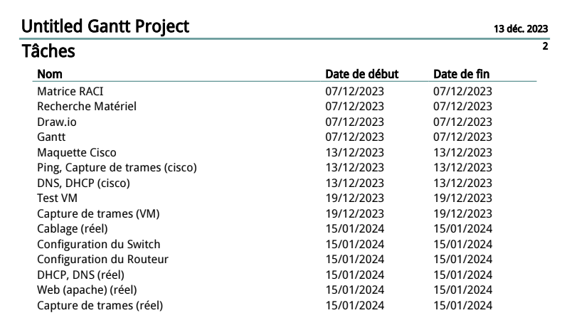
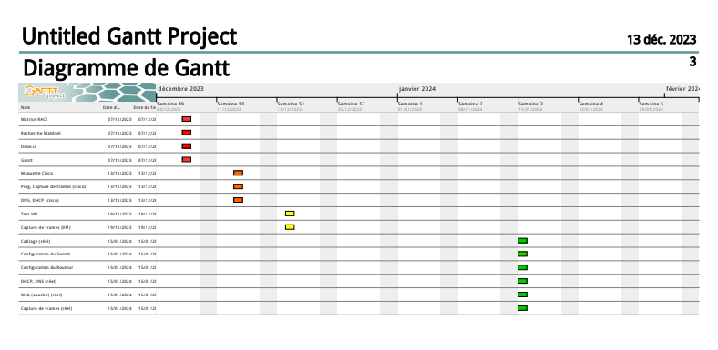
1.Gant

Slide 4
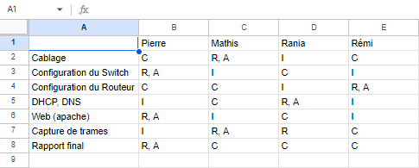
2.Matrice RACI
R = Responsable
A = Autorité
C = Consultant
I = Informé

Slide 5
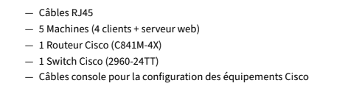
3.Recherche Matérielle
Matérielle requis :
Plus d’informations sur le matérielle utiliser dans le rapport final disponible sur le moodle.

Slide 6
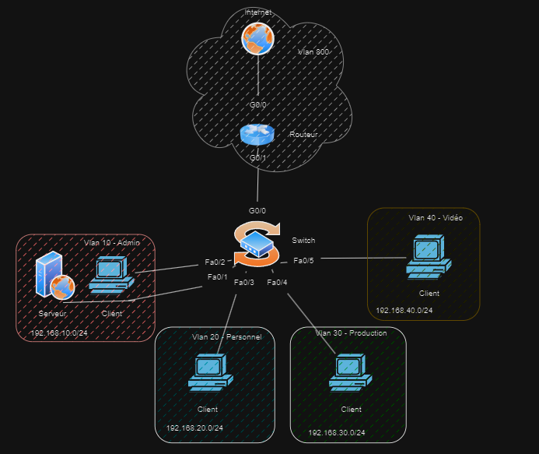
4.Draw.io

Slide 7
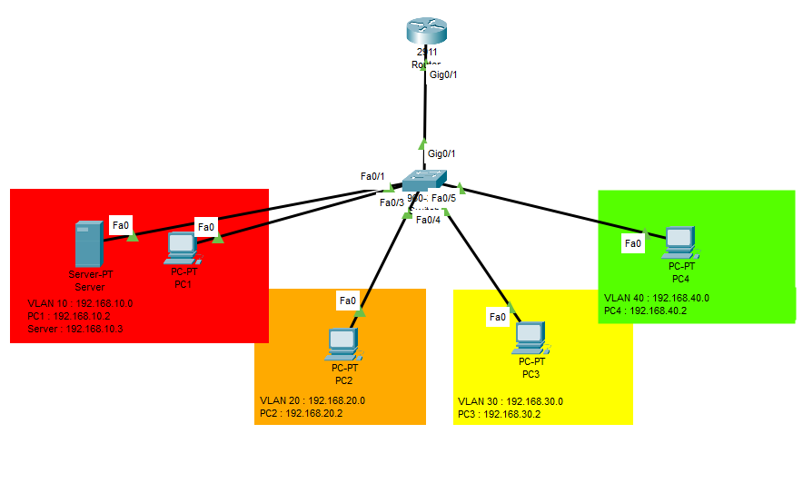
5.Maquette Cisco
IP Machines Clientes et VLAN :
VLAN 10 -> 192.168.10.0 VLAN 20 -> 192.168.20.0
g0/0.10 : 192.168.10.1 g0/0.20 : 192.168.20.1
PC0 : 192.168.10.2 PC1 : 192.168.20.2
WEB : 192.168.10.3
VLAN 30 -> 192.168.30.0 VLAN 40 -> 192.168.40.0
g0/0.30 : 192.168.30.1 g0/0.40 : 192.168.40.1
PC2 : 192.168.30.2 PC3 : 192.168.40.2

Slide 8
6.Configuration VLAN, DNS, DHCP, ACL, (Cisco)
Switch :
vlan 10
name ADMIN
vlan 20
name PERSONNEL
vlan 30
name PRODUCTION
vlan 40
name VIDEO
interface FastEthernet 0/1
switchport access Vlan 10
switchport mode access
interface FastEthernet 0/2
switchport access Vlan 10
switchport mode access
interface FastEthernet 0/3
switchport access Vlan 20
interface FastEthernet 0/4
switchport access Vlan 30
switchport mode access
interface FastEthernet 0/5
switchport access Vlan 40
switchport mode access
interface FastEthernet 0/5
switchport mode trunk

Slide 9
interface GigabitEthernet0/0
no ip address
duplex auto
speed auto
interface GigabitEthernet0/0.1
encapsulation dot1Q 10
ip address 192.168.10.1 255.255.255.0
ip access-group 10 in
interface GigabitEthernet0/0.2
encapsulation dot1Q 20
ip address 192.168.20.1 255.255.255.0
ip access-group 20 in
interface GigabitEthernet0/0.3
encapsulation dot1Q 30
ip address 192.168.30.1 255.255.255.0
ip access-group 30 in
Routeur :Configuration en mode trunk, et DHCP, DNS
ip dhcp pool VLAN 10
network 192.168.10.0 255.255.255.0
default-router 192.168.10.1
ip dhcp pool VLAN 20
network 192.168.20.0 255.255.255.0
default-router 192.168.20.1
ip dhcp pool VLAN 30
network 192.168.30.0 255.255.255.0
default-router 192.168.30.1
ip dhcp pool VLAN 40
network 192.168.40.0 255.255.255.0
default-router 192.168.40.1

Slide 10
interface GigabitEthernet0/0.4
encapsulation dot1Q 40
ip address 192.168.40.1 255.255.255.0
ip access-group 40 in
access-list 10 permit 192.168.10.0 0.0.0.255
access-list 20 permit 192.168.20.0 0.0.0.255
access-list 30 permit 192.168.30.0 0.0.0.255
access-list 40 permit 192.168.40.0 0.0.0.255

Slide 11
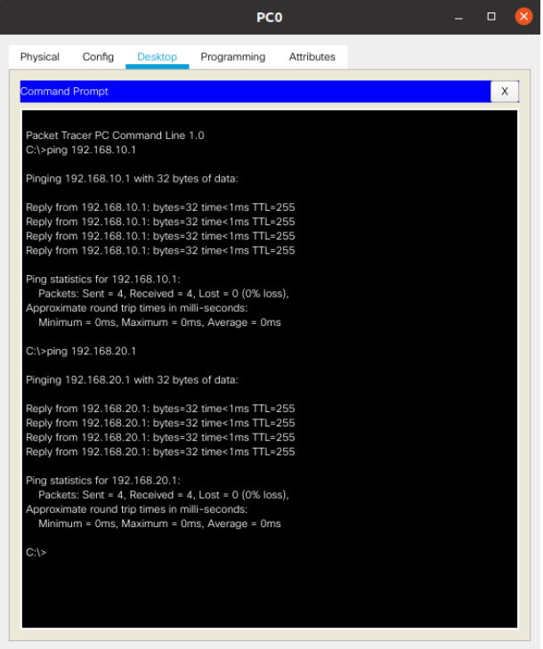
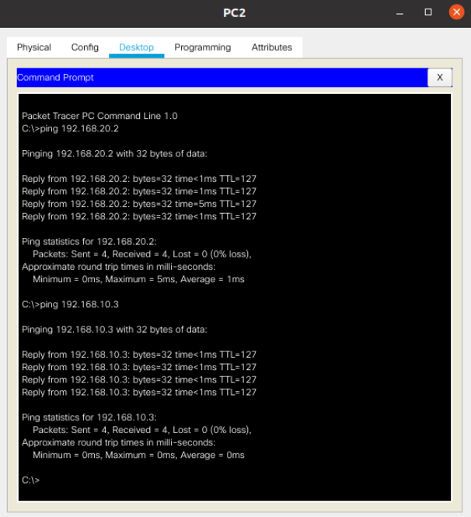
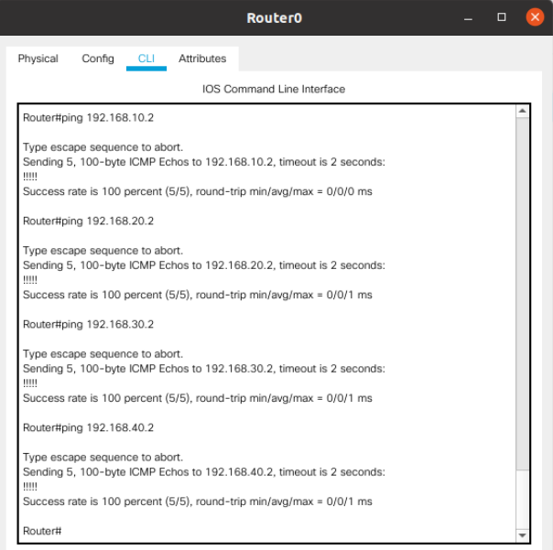
7.Ping (Cisco)
Client vers routeur :
Client vers client:
Routeur vers client :

Slide 12
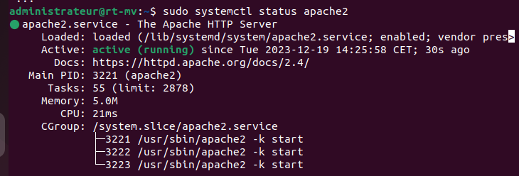
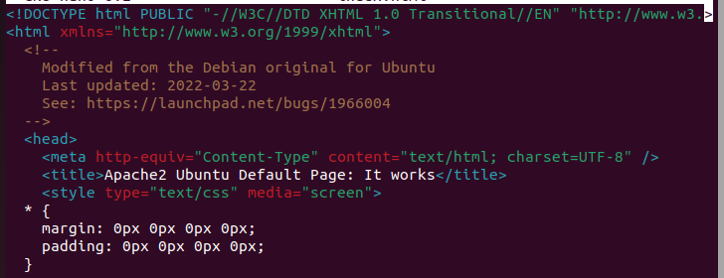
8.Serveur Apache (VM)
Pour la modification du serveur Apache :
cd /var/www/html
sudo -s
nano index.html
Installation du serveur Apache :
sudo apt update
sudo apt install apache2

Slide 13
9.Câblage, Adressage (réel)
 | Poste | Switch
Pierre | port 1.5 | port 1
Rania | port 4.5 | port 4
Remi | port 3.5 | port 3
Mathis | port 2.5 | port 2
Switch | Routeur
g0/1 | g0/0

Slide 14
Adressage :
IP Machines Clientes et VLAN :
VLAN 10 -> 192.168.10.0 VLAN 20 -> 192.168.20.0
g0/0.10 : 192.168.10.1 g0/0.20 : 192.168.20.1
PC0 : 192.168.10.2 PC1 : 192.168.20.3
WEB : 192.168.10.3
VLAN 30 -> 192.168.30.0 VLAN 40 -> 192.168.40.0
g0/0.30 : 192.168.30.1 g0/0.40 : 192.168.40.1
PC2 : 192.168.30.3 PC3 : 192.168.40.2

Slide 15
10.Configuration VLAN, DNS, DHCP, ACL, NAT
interface FastEthernet 0/1
switchport access Vlan 10
switchport mode access
interface FastEthernet 0/2
switchport access Vlan 20
switchport mode access
interface FastEthernet 0/3
switchport access Vlan 30
switchport mode access
Switch :
vlan 10
name ADMIN
vlan 20
name PERSONNEL
vlan 30
name PRODUCTION
vlan 40
name VIDEO
interface FastEthernet 0/4
switchport access Vlan 40
switchport mode access
interface FastEthernet 0/5
switchport access Vlan 10
switchport mode access
interface Gigabit g0/1
switchport mode trunk

Slide 16
Routeur - Configuration en mode trunk, et DHCP, DNS
ip dhcp pool VLAN 10
network 192.168.10.0 255.255.255.0
default-router 192.168.10.1
dns-server 10.0.0.1
ip dhcp pool VLAN 20
network 192.168.20.0 255.255.255.0
default-router 192.168.20.1
dns-server 10.0.0.1
ip dhcp pool VLAN 30
network 192.168.30.0 255.255.255.0
default-router 192.168.30.1
dns-server 10.0.0.1
ip dhcp pool VLAN 40
network 192.168.40.0 255.255.255.0
default-router 192.168.40.1
dns-server 10.0.0.1
interface GigabitEthernet0/0
no ip address
duplex auto
speed auto
interface GigabitEthernet0/0.1
encapsulation dot1Q 10
ip address 192.168.10.1 255.255.255.0
ip access-group 10 in
interface GigabitEthernet0/0.2
encapsulation dot1Q 20
ip address 192.168.20.1 255.255.255.0
ip access-group 20 in

Slide 17
interface GigabitEthernet0/0.3
encapsulation dot1Q 30
ip address 192.168.30.1 255.255.255.0
ip access-group 30 in
interface GigabitEthernet0/0.4
encapsulation dot1Q 40
ip address 192.168.40.1 255.255.255.0
ip access-group 40 in
access-list 10 permit 192.168.10.0 0.0.0.255
access-list 20 permit 192.168.20.0 0.0.0.255
access-list 30 permit 192.168.30.0 0.0.0.255
access-list 40 permit 192.168.40.0 0.0.0.255

Slide 18
11.Serveur Web apache (réel)
Pour la modification du serveur Apache :
cd /var/www/html
sudo -s
nano index.html
Installation du serveur Apache :
export http_proxy=cache-etu.univ-artois.fr:3128
export https_proxy=cache-etu.univ-artois.fr:3128
sudo apt update
sudo apt install apache2

Slide 19
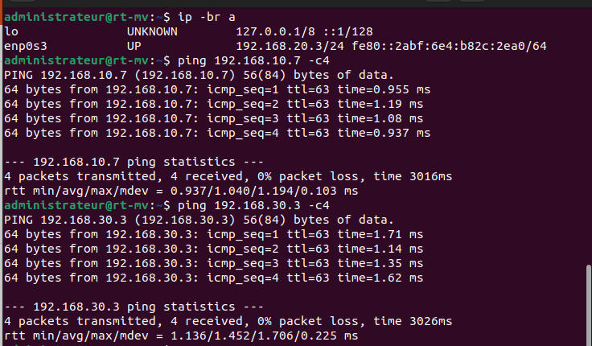
12.Ping (réel)

